Slide 1



X-O Project
Designing an AI for Tic-Tac-Toe
Team Members and AI Agent Overview

Slide 2


Team Members
محمد ضياء السيد عبد الحي محمود (سكشن: 7)
1
Team
محمد سمير مجاهد أبو الوفا الزيني (سكشن: 7)
2
محمد خالد محمد عبد الرحيم محمد وفا (سكشن: 6)
3

Slide 3
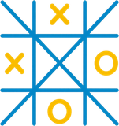
Project Proposal
Design an AI agent capable of playing Tic-Tac-Toe (X-O) against human or computer opponents.
1
Goals
Agent analyzes the current board state and strategically selects the optimal move.
2
Ultimate goal: achieve victory or prevent the opponent from winning.
3

Slide 4

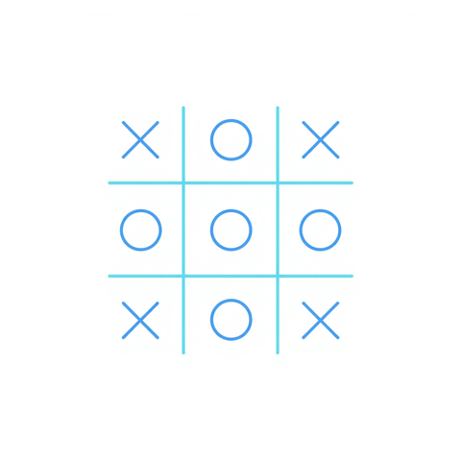
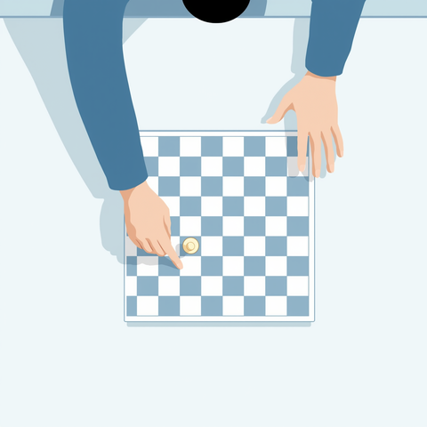

PEAS Analysis
The PEAS framework guides our AI agent design for Tic-Tac-Toe, defining how it perceives, acts, and succeeds in the game environment.
PEAS

Slide 5


Environment Characteristics
Observable: The game board is fully observable - all cells visible to the agent at all times.
1
Deterministic: Every action has a predictable outcome - placing X or O in a cell is certain.
2
ODESDA
Episodic: Sequential - each move depends on previous game states and affects future decisions.
3

Slide 6

Environment Characteristics
Static: The board state does not change while the agent is deciding its move.
1
Discrete: Finite number of board states and possible actions available.
2
ODESDA
Multi-Agent: Two players (X and O) compete against each other.
3

Slide 7
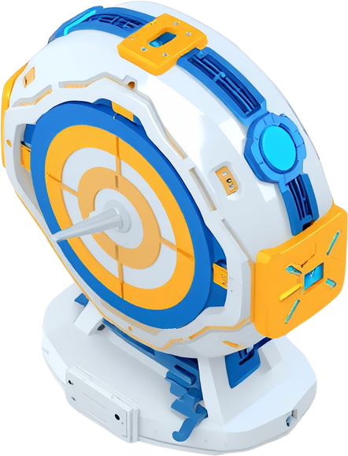
Agent Type
Our AI agent is designed as a Goal-based Reflex Agent. It analyzes the current board state and selects moves based on a clear objective: win the Tic-Tac-Toe game or block the opponent from winning.
Agent

Slide 8

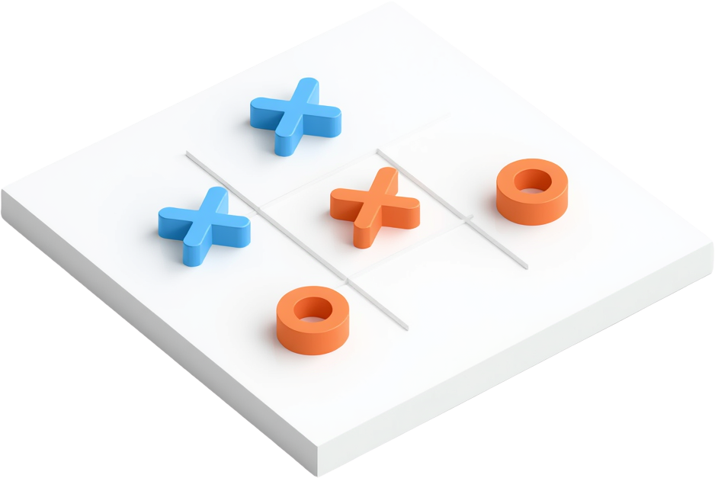
Tic-Tac-Toe Game Board
The board environment where the AI agent operates. A simple 3x3 grid serves as the playing field for both the human player and the AI agent.

Slide 9

How the AI Chooses Moves
The AI agent analyzes the current board state to identify all possible moves. It evaluates each option by checking for winning opportunities first, then blocking opponent wins, and finally selecting strategic positions like the center or corners.
Process

Slide 10
Summary
AI agent designed to play Tic-Tac-Toe intelligently using strategic decision-making.
1
10
PEAS framework guided the agent design with clear performance measures.
2
Goal-based reflex agent aims to win or achieve a draw against opponents.
3

Slide 11

Questions?
Thank you for your attention.
We welcome any questions or discussion about the x-O Project and our AI agent design.
Thank You

